Slide 1
MAT 350 Engineering Mathematics
Modeling with 2nd order ODE:
Mass–Spring System.
Lecture: 5
Dr. M. Sahadet Hossain (MtH)
Professor
Department of Mathematics and Physics, NSU.

Slide 2
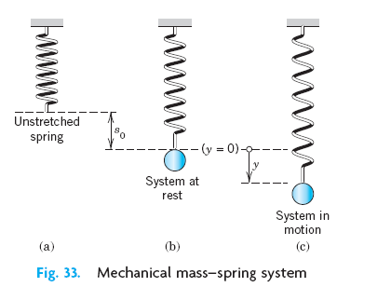
Modeling of Free Oscillations of a
Mass–Spring System
Linear ODEs with constant coefficients have important applications in mechanics, and in electrical circuits.
In this section we model and solve a basic mechanical system consisting of a mass on an elastic spring (a so-called “mass–spring system,” Fig. below), which moves up and down.

Slide 3



(1)
(2)
If the damping is small and the motion of the system is considered over a relatively short time, we may disregard damping.
Then Newton’s law with F=- F₁ gives the model
(3)

Slide 4



This is a homogeneous linear ODE with constant coefficients. A general solution is obtained as
(4)
This motion is called a harmonic oscillation. Its frequency is
The frequency f is called the natural frequency of the system.
Please note,

Slide 5

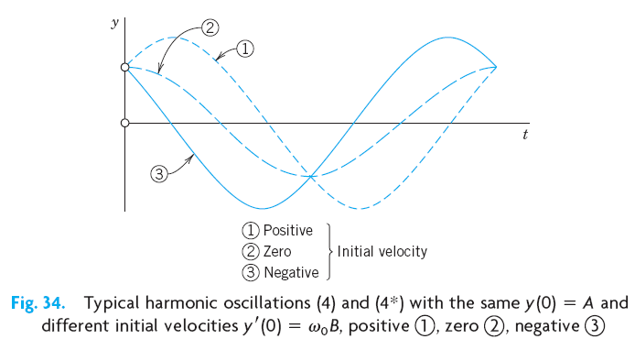
An alternative representation of (4), which shows the physical characteristics of amplitude and phase shift of (4), is

Slide 6


Modeling of Free Oscillations of a Mass–Spring System
Example 1: If a mass–spring system with an iron ball of weight W=98 nt (about 22 lb) can be regarded as undamped, and the spring is such that the ball stretches it 1.09 m (about 43 in.), how many cycles per minute will the system execute?
(a) Write the Mathematical model of the mass-spring system
(b) Find a solution for the undamped oscillation of the mass-spring system
(c) What will its motion be if we pull the ball down from rest by 16 cm (about 6 in. and let it start with zero initial velocity?
Solution. Hooke’s law with W as the force and 1.09 meter as the stretch gives
W= 1.09 k (since W=ky, y displacement)
Generate mathematical model
Frequencey, f =

Slide 7

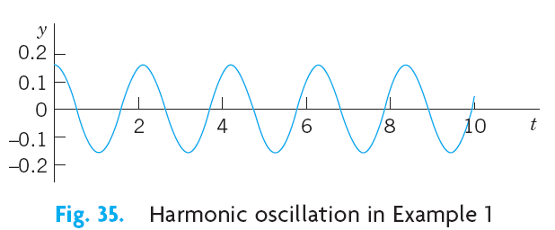
Initial conditions
Note that
. Hence
Hence B=0, and δ = tan⁻¹ (B/A)=0,
Therefore, the general solution is:
Here, 16 cm=0.16 m
C=sqrt(A²+B²)

Slide 8

ICECE 2020
Examples: from Zill 10th edition.
Example 2: A mass weighing 2 pounds stretches a spring 6 inches. At t=0 the mass is released from a point 8 inches below the equilibrium position with an upward velocity of 4/3 ft/s.
Determine the equation of motion. (example 1 of D. Zill chp 5.1)
SOLUTION:
Because we are using the engineering system of units, the measurements given in terms of inches must be converted into feet
In addition, we must convert the units of weight given in pounds into units of mass.

Slide 9




Here the negative sign in the last condition is a consequence of the fact that the mass is given an initial velocity in the negative, or upward direction.
Thus, the equation of motion is

Slide 10
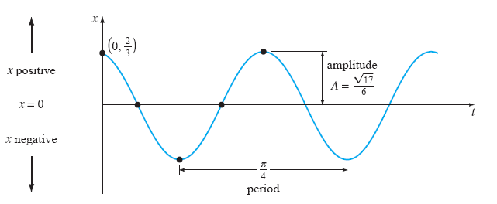

Slide 11
Exercises 5.1 (Zill)
6. A force of 400 newtons stretches a spring 2 meters.
A mass of 50 kilograms is attached to the end of the
spring and is initially released from the equilibrium
position with an upward velocity of 10 m/s. Find the
equation of motion.
8. A mass weighing 32 pounds stretches a spring 2 feet.
Determine the amplitude and period of motion if the
mass is initially released from a point 1 foot above the
equilibrium position with an upward velocity of 2 ft/s.
#9, #10

Slide 12


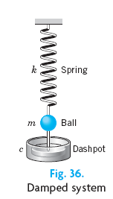




ODE of the Damped System

Slide 13

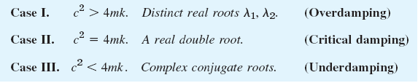

Slide 14


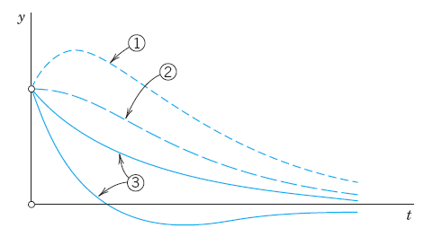
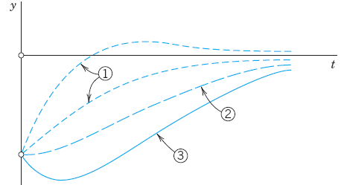


Slide 15


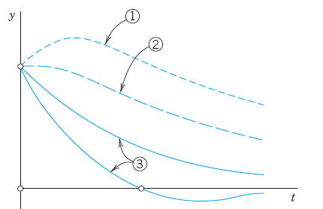
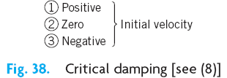

Slide 16





Slide 17

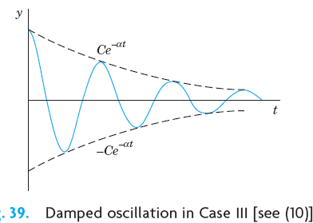

Slide 18
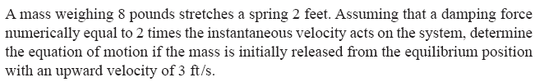
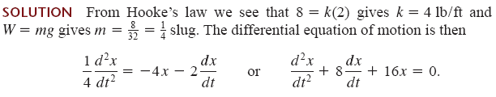

Example 3: Damping motion (Critically damped)
Auxiliary equation is:

Slide 19

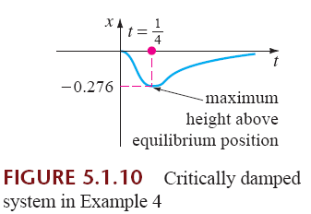

Slide 20
Example: (Underdamped condition)
A mass weighing 16 pounds is attached to a 5-foot-long spring. At equilibrium the spring measures 8.2 feet. If the mass is initially released from rest at a point 2 feet above the equilibrium position, find the displacements x(t) if it is further known that the surrounding medium offers a resistance numerically equal to the instantaneous velocity.

Slide 21


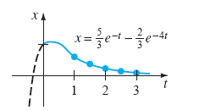
Example 3: Damping motion (overdamped)
Consider the overdamped motion described by the equation below. The mass is initially released from a position 1 unit below the equilibrium position with a downward velocity of 1 ft/s.

Slide 22














Consider the motion in Example 1 (of free oscillation) change if we change the damping constant c from one to another of the
following three values

Slide 23



Slide 24




Since c =10 is smaller than the critical c, we shall get oscillations.

Slide 25
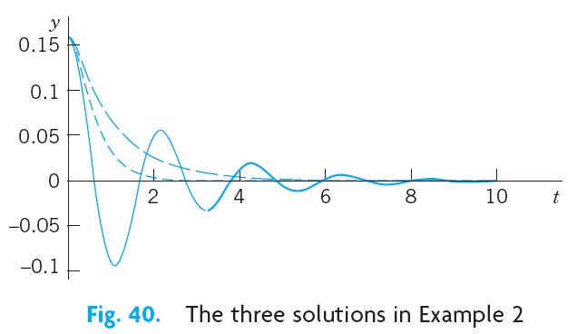

Slide 26
Exercise 5.1 (Zill)
22. A 4-foot spring measures 8 feet long after a mass weighing
8 pounds is attached to it. The medium through which the mass moves offers a damping force numerically equal to times the instantaneous velocity.
(a) Find the equation of motion if the mass is initially released
from the equilibrium position with a downward velocity
of 5 ft/s.
(b) Find the time at which the mass attains its extreme displacement from the equilibrium position.
(c ) What is the position of the mass at this instant?

Slide 27
Exercise 5.1 (Zill)
22. A 4-foot spring measures 8 feet long after a mass weighing
8 pounds is attached to it. The medium through which the mass moves offers a damping force numerically equal to times the instantaneous velocity.
(a) Find the equation of motion if the mass is initially released
from the equilibrium position with a downward velocity
of 5 ft/s.
(b) Find the time at which the mass attains its extreme displacement from the equilibrium position.
(c ) What is the position of the mass at this instant?
Problems# 21, 25, 26

